Slide 1
Inelastic scattering by phonons
Gediminas Simutis :: Paul Scherrer Institute
Nordic Neutron School, Tartu, October 29th, 2021

Slide 2
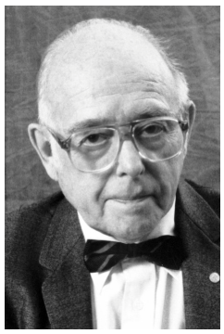
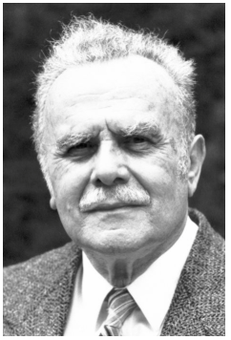

Neutron scattering
Neutrons see where the atoms are and what they do
1994 Clifford G. Shull Bertram N. Brockhouse

Slide 3
Overview
Introduction
What are phonons?
INS cross section
Practical aspects
Examples:
  Soft-mode transition in SrTiO₃
  Kohn anomalies
  Phonons in superconductors
  Phonons in quantum magnets

Slide 4
Lattice excitations
Phonons are important for understanding:
Specific heat
Structural and electronic
instabilities
Electron coupling in superconductors
…

Slide 5



A simple example
Molecular vibrations
O₂ molecule, E = 0.25 eV, ‘stretching mode’
No momentum dependence

Slide 6
A simple example
A chain of atoms connected by springs
a

Slide 7

A simple example
A chain of atoms connected by springs
a

Slide 8
A simple example
A chain of atoms connected by springs
a
Small movements around equilibrium
u_{n-1}
u_{n}
u_{n+1}

Slide 9
A simple example
A chain of atoms connected by springs
a
Small movements around equilibrium
u_{n-1}
u_{n}
u_{n+1}

Slide 10
A simple example
A chain of atoms connected by springs
a
Small movements around equilibrium
u_{n-1}
u_{n}
u_{n+1}

Slide 11
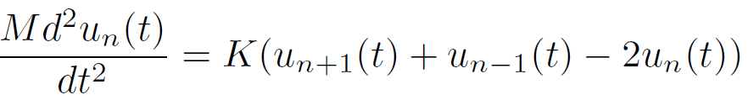
A simple example
A chain of atoms connected by springs
a
Small movements around equilibrium
u_{n-1}
u_{n}
u_{n+1}
Using Newton’s
2nd law, equate to

Slide 12

A simple example
A chain of atoms connected by springs
a
Small movements around equilibrium
u_{n-1}
u_{n}
u_{n+1}
Using Newton’s
2nd law, equate to
Now taking the
plane wave ansatz

Slide 13





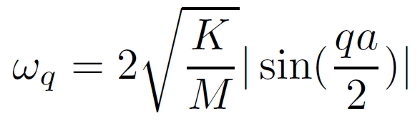
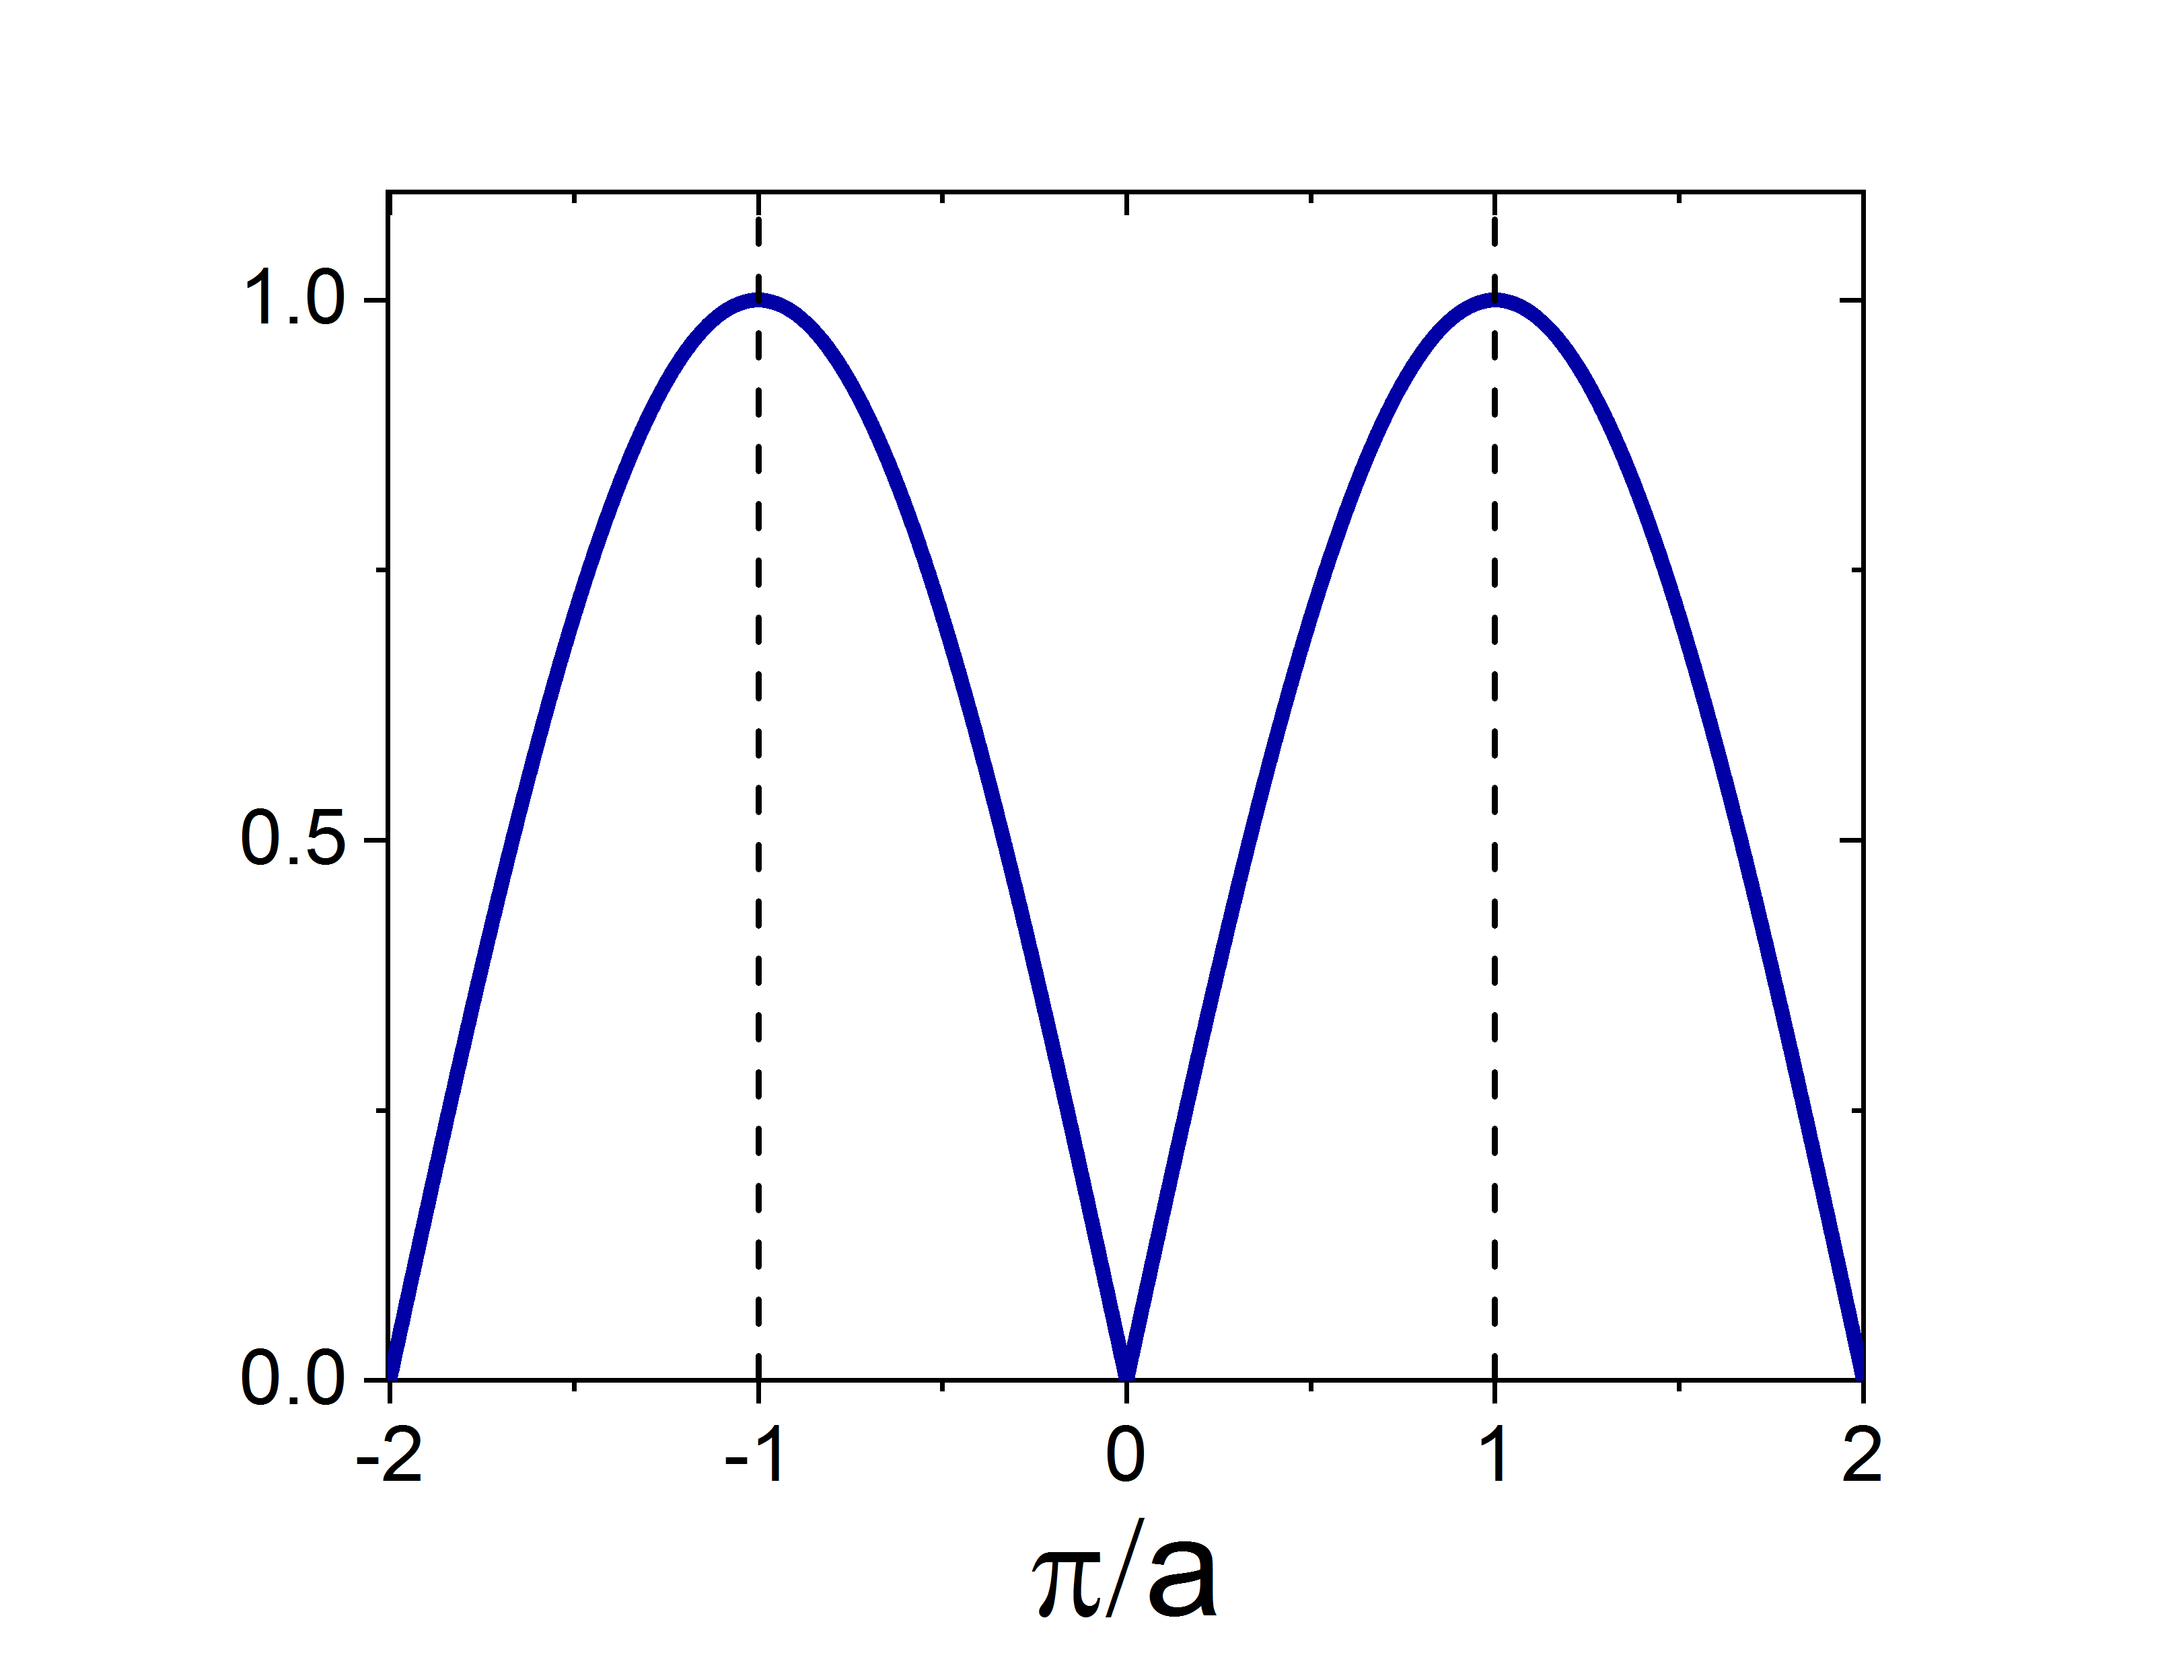

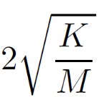
with
rearrange and use Euler
+ double angle identity

Slide 14
Different Atoms
Two different atoms per unit cell
a

Slide 15
Different Atoms
Two different atoms per unit cell
M₁ M₂
a
u_{2n-1}
u_{2n}
u_{2n+1}

Slide 16
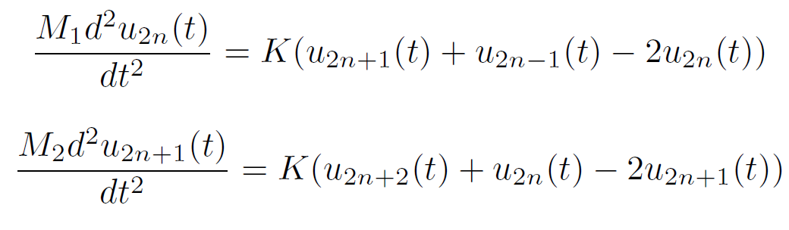


Different Atoms
Two different atoms per unit cell
M₁ M₂
a
u_{2n-1}
u_{2n}
u_{2n+1}
Two differential equation and two trial solutions for the different atoms
Substitution provides:

Slide 17
Different Atoms

Slide 18
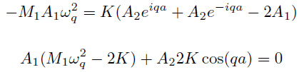
Different Atoms

Slide 19
Different Atoms

Slide 20
Different Atoms

Slide 21

Different Atoms

Slide 22
Different Atoms

Slide 23


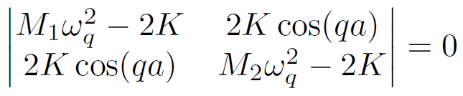
Different Atoms
If invertible
X = A^-1 b,
But b = 0,
So only trivial
Homogeneous equations ->
to solve, set determinant to zero

Slide 24
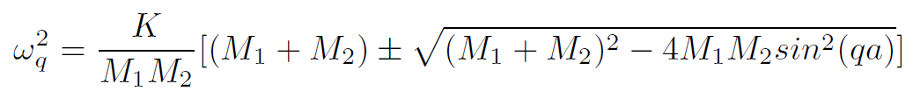
Different Atoms
Homogeneous equations ->
to solve, set determinant to zero

Slide 25
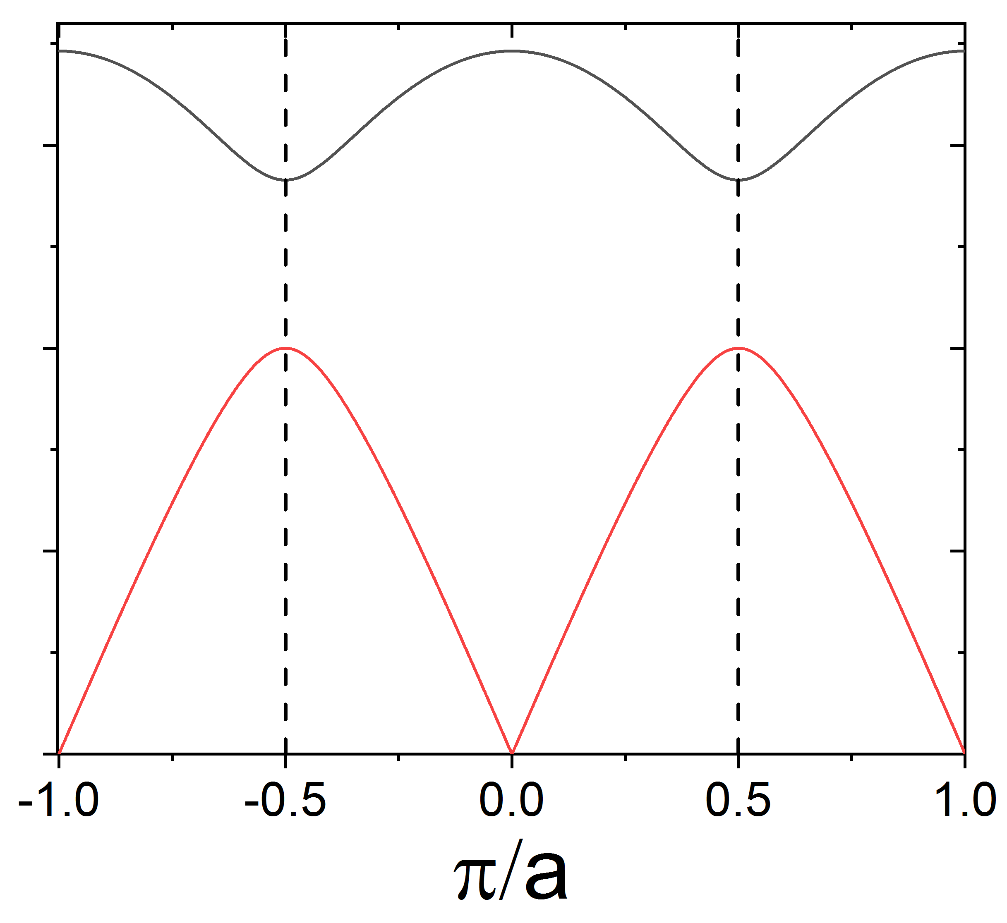
Different Atoms
Homogeneous equations ->
to solve, set determinant to zero

Slide 26
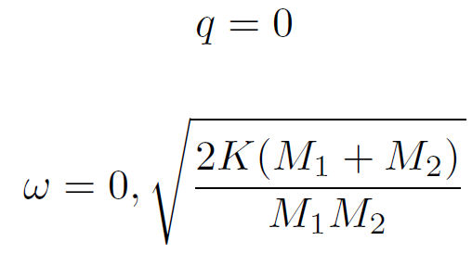
Different Atoms
Homogeneous equations ->
to solve, set determinant to zero
Limits

Slide 27
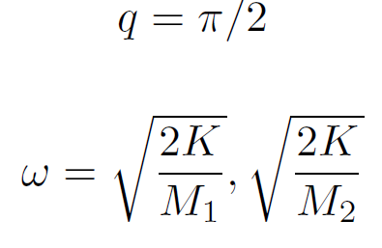
Different Atoms
Homogeneous equations ->
to solve, set determinant to zero
Limits

Slide 28
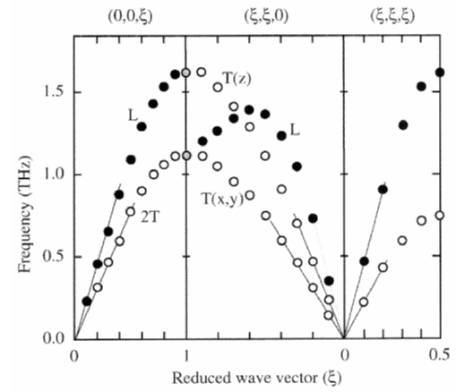
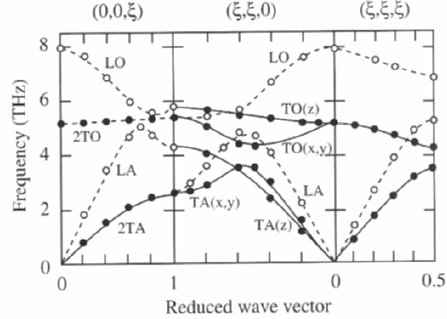
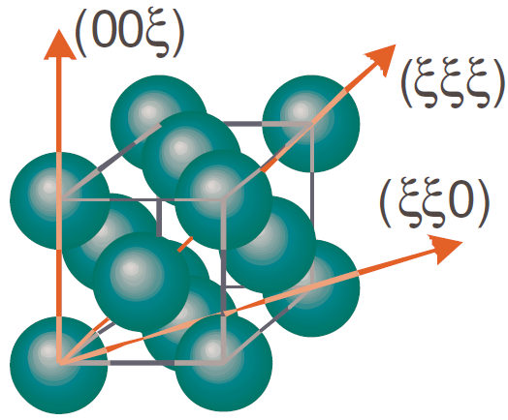
Measured phonons
Monoatomic (Neon) Diatomic (NaCl)
6.5 and 23.7 K (melting point, 24.6 K)
1 THz = 4 meV
VdW
Raunio et al., 1969
Endoh et al., 1975

Slide 29
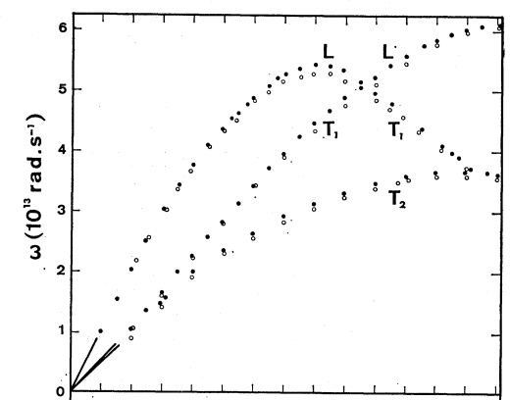
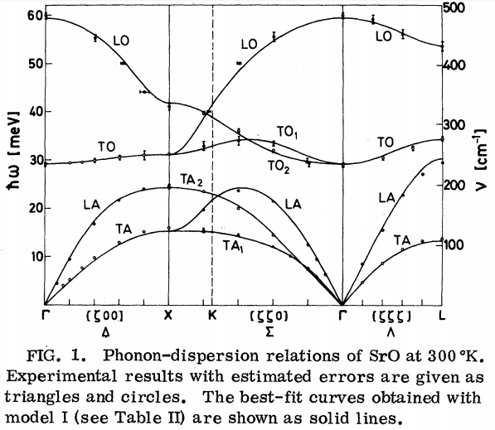
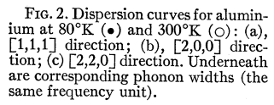
Measured phonons
Monoatomic (Al) Diatomic (SrO)
Rieder et al., 1975
Stedman, Nilsson, 1965

Slide 30
Measured phonons
Monoatomic Diatomic
Total number of normal modes = 3N,
Where N = # of atoms in unit cell
3 of them acoustic, other – optical
Speed of sound = dω/dq
Rieder et al., 1975
Stedman, Nilsson, 1965

Slide 31
A note on quantum derivation
Operators!

Slide 32
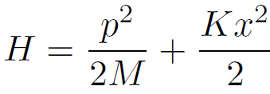
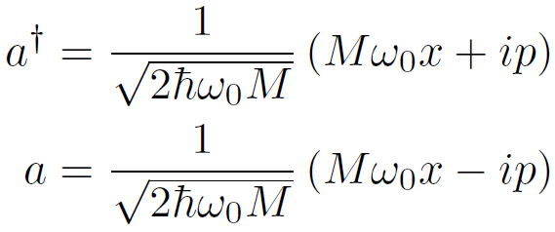


A note on quantum derivation
Operators!
Harmonic oscillator
Substitute by raising and lowering
Rearrange for x and p and sub
___
number operator

Slide 33
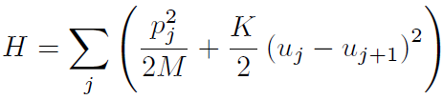

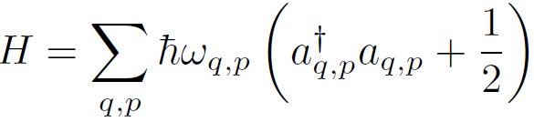
A note on quantum derivation
Operators!
Harmonic oscillator
Substitute by raising and lowering
Rearrange for x and p and sub
___
number operator
One dimension
After a similar procedure – q !
Three dimensions
q and polarization p

Slide 34
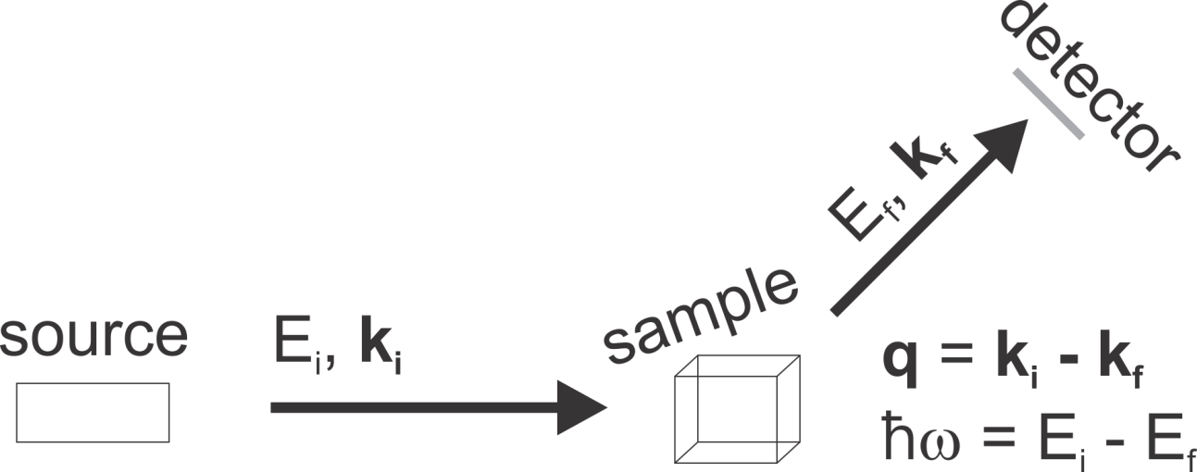

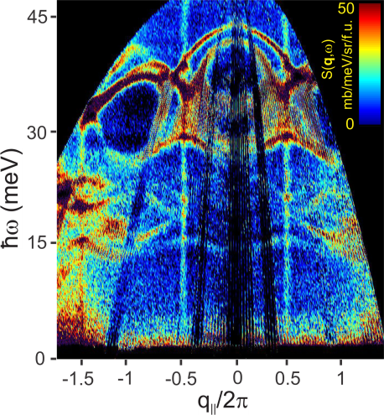
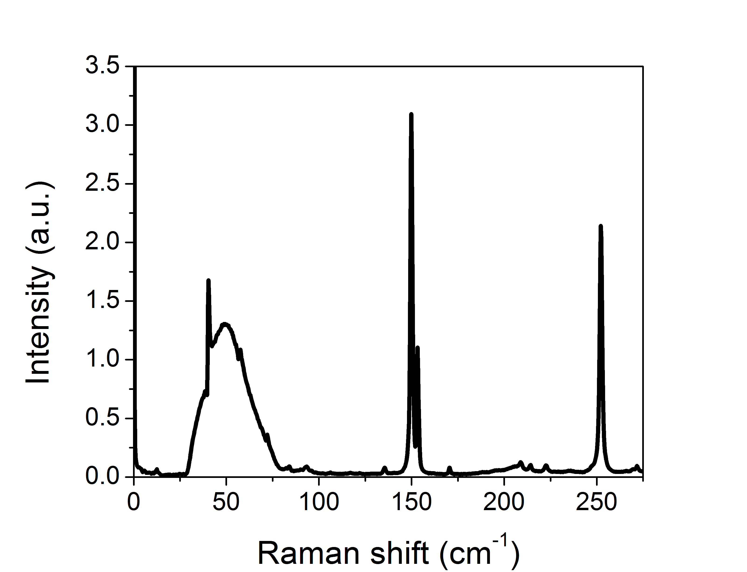
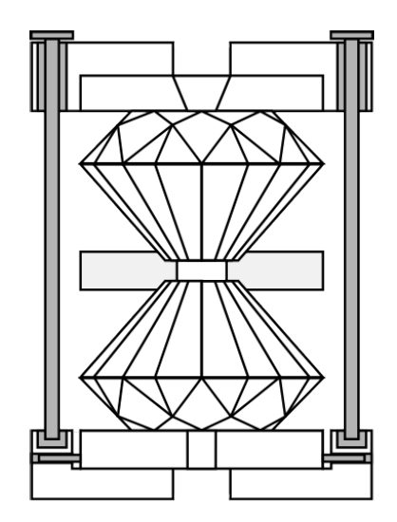
How to measure, cf Raman/IR
BZ ~ 1/a
q_{max} ~ 2k ~ 1/λ
Neutron spectroscopy
cross section
spectrum (q-dep)
Raman spectroscopy
cross section
spectrum (q~0 only)

Slide 35
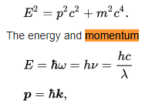

How to measure, cf Raman/IR
IXS:
Baron,
arXiv:1504.01098
~ 10 keV
Neutron spectroscopy
cross section
spectrum (q-dep)
Raman spectroscopy
cross section
spectrum (q~0 only)

Slide 36
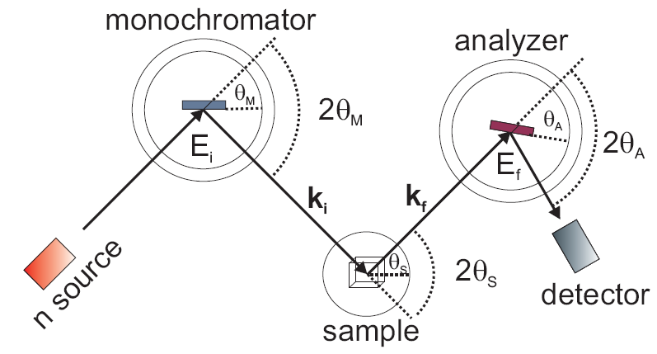
Three-axis spectroscopy

Slide 37
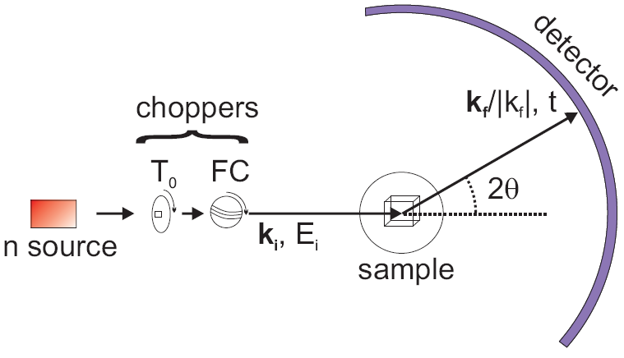
Time-of-flight spectroscopy

Slide 38
Scattering cross section

Slide 39
Scattering cross section
Prefactors Transition probability E-conservation
(Fermi Golden Rule)

Slide 40
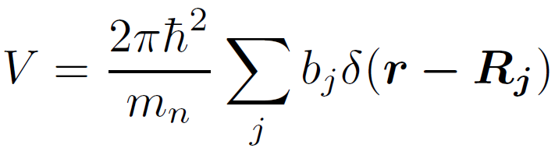
Scattering cross section
Prefactors Transition probability E-conservation
(Fermi Golden Rule)
After manipulations arrive at a general function:
Property of the sample
For detailed derivation, see for example Ch2 of Squires

Slide 41
Phonon cross section
The general form can be calculated for specific cases.
Example: 1-phonon scattering

Slide 42
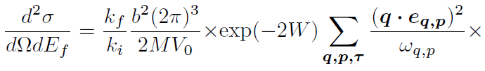

Phonon cross section
The general form can be calculated for specific cases.
Example: 1-phonon scattering

Slide 43
Phonon cross section
The general form can be calculated for specific cases.
Example: 1-phonon scattering
Phonon emission
Phonon absorption

Slide 44


Phonon cross section
The general form can be calculated for specific cases.
Example: 1-phonon scattering
Scales as
And 1/

Slide 45


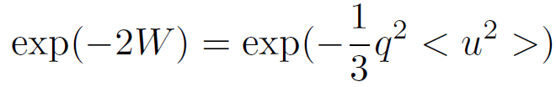
Phonon cross section
The general form can be calculated for specific cases.
Example: 1-phonon scattering
Debye-Waller factor
Population factors
(reduction of intensity:
phonons relevant also
for elastic scattering)
For a cubic system

Slide 46
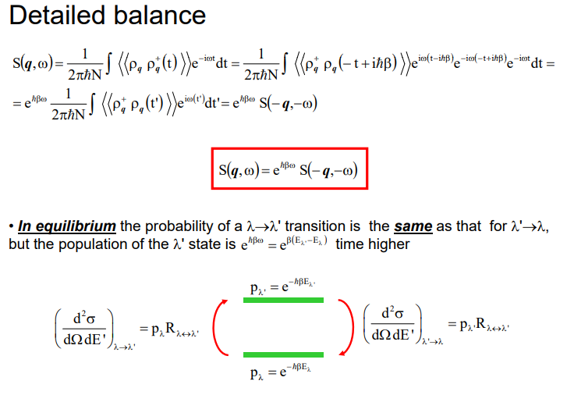





Effect of temperature
Detailed balance principle
Your sample is also a thermometer!

Slide 47
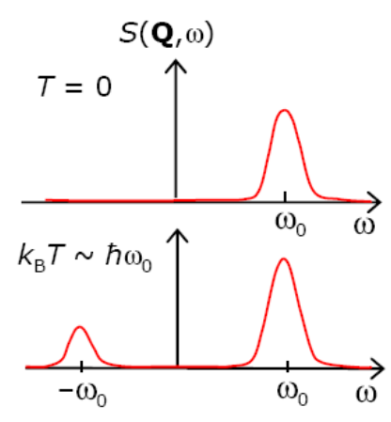
Effect of temperature
Detailed balance

Slide 48
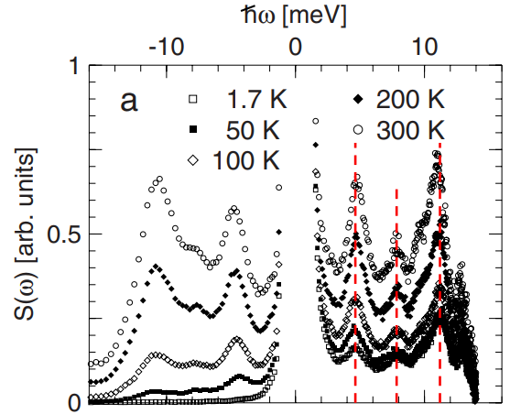
Effect of temperature
Detailed balance
Ba₈Ge₃₈Zn₈
Koza et al., (2010)

Slide 49
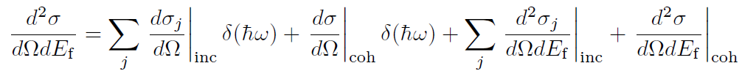
Incoherent Scattering
Total scattering cross section
So far we have been discussing only the coherent case
Pair correlation function
“probability G(r,t) of finding an atom at (r,t) given that there is another
atom at r = 0 at time t = 0”
Incoherent scattering – self correlation function
“probability G(r,t) of finding the same atom at (r,t) given that the same atom
was at r = 0 at time t = 0”
In practice, the relative importance is nucleus dependent
https://www.nist.gov/ncnr/neutron-scattering-lengths-list

Slide 50



Incoherent Scattering
DOS of phonons
Can be used to obtain
absolute cross-section

Slide 51
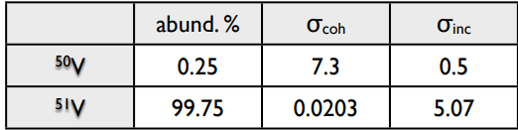


Incoherent Scattering
DOS of phonons
Can be used to obtain
absolute cross-section

Slide 52
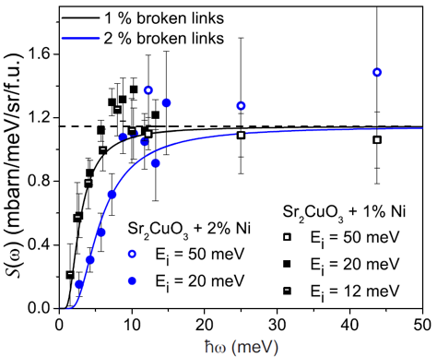
Incoherent Scattering
DOS of phonons
Can be used to obtain Accurate comparison with models
absolute cross-section
GS et al., (2017)

Slide 53
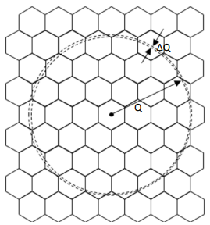
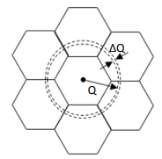
Incoherent Scattering
DOS of phonons
The cross-section is the same for powder samples at high q
(Incoherent approximation)
low q: high q:
small part of BZ all BZ
coherence effects incoherent
This is how DOS of phonons is usually obtained
Taken from ISIS n-school

Slide 54
Phonon widths
Peaks in Energy dependence
have finite widths
Resolution + phonon lifetime
Axe and Shirane (1973)
Brockhouse et al., (1962): Phonons in Pb

Slide 55
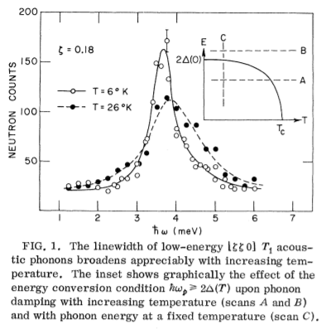
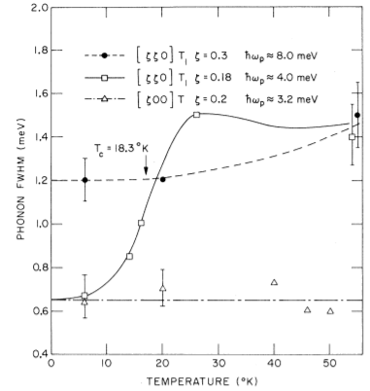
Phonon widths
Peaks in Energy dependence
have finite widths
Resolution + phonon lifetime
Phonons and superconductivity
Nb₃Sn
Phonons with energy less than the
SC gap have fewer decay channels
(electron-hole decay suppressed)
Axe and Shirane (1973)
Brockhouse et al., (1962): Phonons in Pb

Slide 56
Examples

Slide 57
Examples
  Soft-mode transition in SrTiO₃
  Kohn anomalies
  Phonons in superconductors
  Phonons in quantum magnets

Slide 58
Examples
  Soft-mode transition in SrTiO₃
  Kohn anomalies
  Phonons in superconductors
  Phonons in quantum magnets

Slide 59
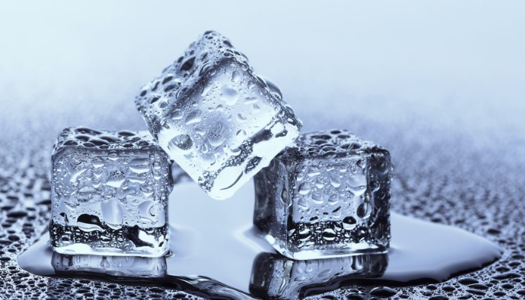
Phases and Phase Transitions

Slide 60
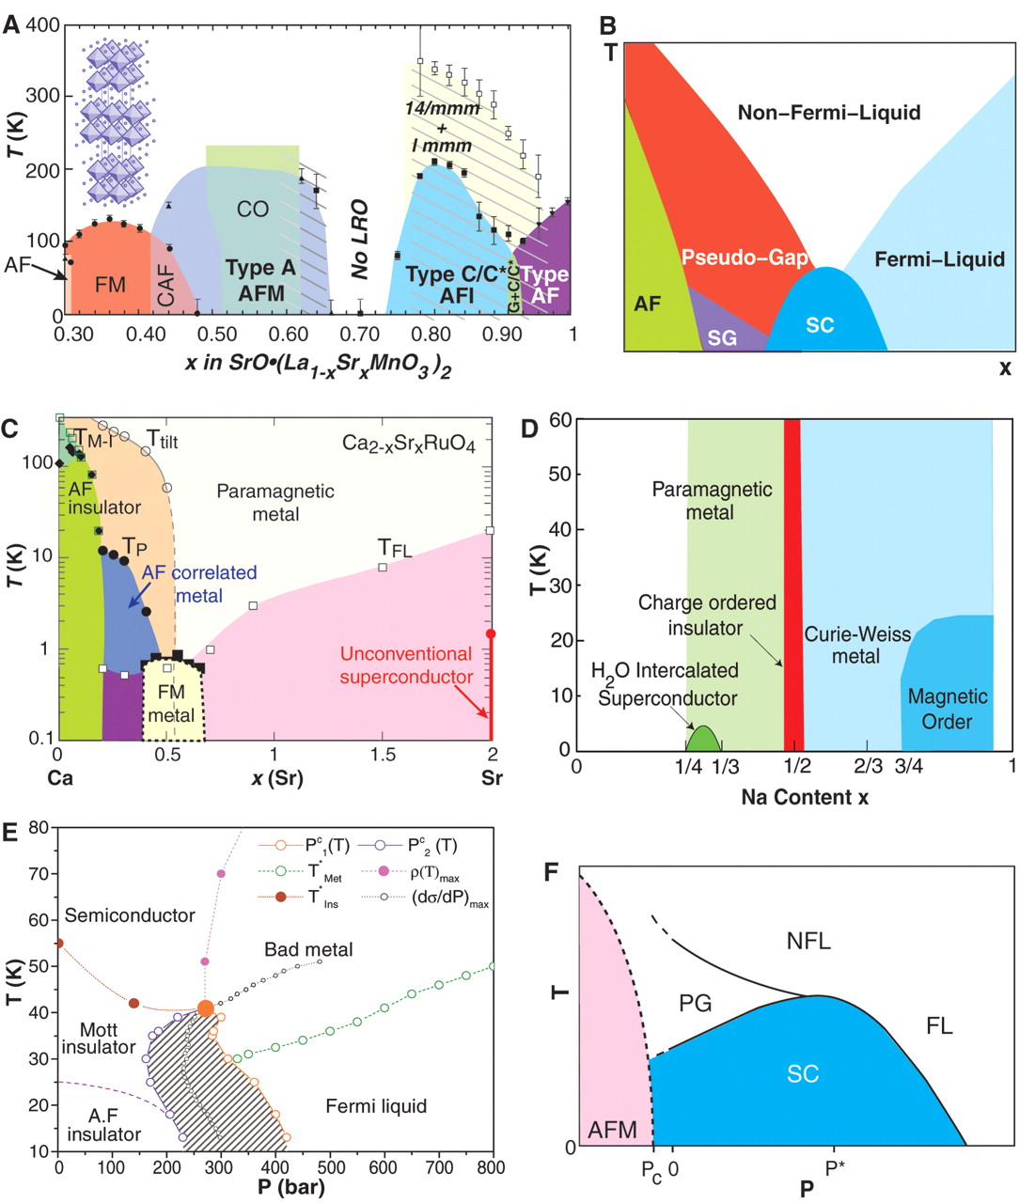
Phases and Phase Transitions
Dagotto 2005

Slide 61
Phases and Phase Transitions
Dagotto 2005
How do they take place?

Slide 62
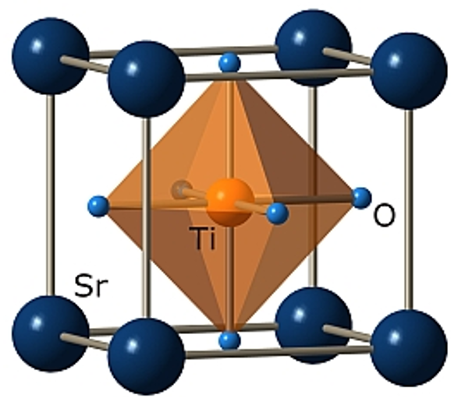
Structural transition in SrTiO₃
Cubic perovskite at Tetragonal at
room temperature low temperature
Shirane, Yamada 1969

Slide 63
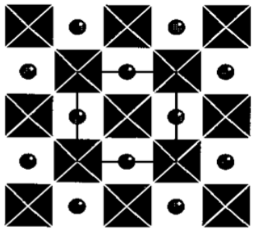
Structural transition in SrTiO₃
Cubic perovskite at Tetragonal at
room temperature low temperature
Shirane, Yamada 1969

Slide 64
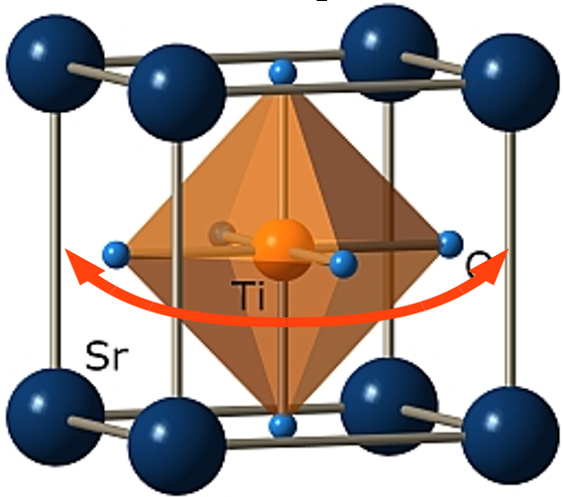
Structural transition in SrTiO₃
Cubic perovskite at Tetragonal at
room temperature low temperature
~ 108 K
Shirane, Yamada 1969

Slide 65
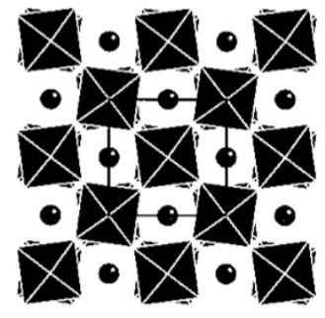
Structural transition in SrTiO₃
Cubic perovskite at Tetragonal at
room temperature low temperature
~ 108 K
Shirane, Yamada 1969

Slide 66
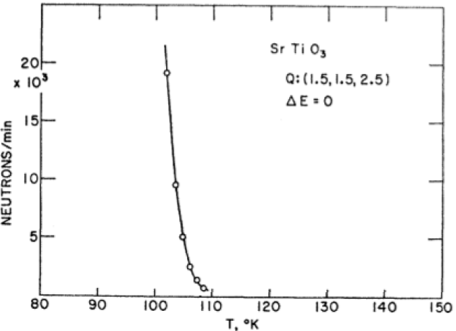
Structural transition in SrTiO₃
Step 1 – structure
New Bragg peaks
appear at LT

Slide 67



Structural transition in SrTiO₃
Step 1 – structure
New Bragg peaks
appear at LT

Slide 68

Structural transition in SrTiO₃
Step 2 – dynamics: phonon spectrum

Slide 69
Structural transition in SrTiO₃
Step 2 – dynamics: phonon spectrum

Slide 70

Structural transition in SrTiO₃
Step 3 – The soft phonon

Slide 71

Structural transition in SrTiO₃
Step 3 – The soft phonon

Slide 72
Structural transition in SrTiO₃
Step 3 – The soft phonon

Slide 73

Structural transition in SrTiO₃
Step 3 – The soft phonon
Energy goes to 0 as T approaches TC
The structure is unstable to this phonon

Slide 74



Structural transition in SrTiO₃
Step 3 – The soft phonon
Triply degenerate
2 + 1 degeneracy

Slide 75
Summary of SrTiO₃ story
Neutrons could see:
structure change
and
the excitations that are responsible for it
Frozen phonon mechanism
Change of degeneracies between
different structures.
The triply degenerate soft mode is split by
the distortion into a singlet mode with the
rotation axis parallel to the static distortion
and a doublet mode with the rotation axes
perpendicular to the distortion

Slide 76
More of SrTiO₃ story
Albeit an archetypical transition,
it shows unusual critical indexes:
Critical fluctuations
Experiments observe two energy scales
and two length scales
(See for example Cowley 1996)

Slide 77
Examples
  Soft-mode transition in SrTiO₃
  Kohn anomalies
  Phonons in superconductors
  Phonons in quantum magnets

Slide 78
How about the electrons ?
Previous example – electrons irrelevant.
Is it always the case?

Slide 79
How about the electrons ?
Previous example – electrons irrelevant.
(often think about Born-Oppenheimer)
Is it always the case?

Slide 80

How about the electrons ?
Previous example – electrons irrelevant.
(often think about Born-Oppenheimer)
Is it always the case? Let’s start with
electrons this time. Fermi sea to be precise

Slide 81

How about the electrons ?
Previous example – electrons irrelevant.
(often think about Born-Oppenheimer)
Is it always the case? Let’s start with
electrons this time. Fermi sea to be precise

Slide 82


Instabilities at Fermi surface
Charge density wave
(CDW)

Slide 83




Lindhard’s functions
χ
In 1-D – divergence
Higher D – no (sphere)

Slide 84




Lindhard’s functions
χ
In 1-D – divergence
Higher D – no (sphere)
1D nesting 2D – no 2D - partial
However, even at D > 1
CDW can occur in the
case of nesting:
shape of fermi surface!

Slide 85



Lindhard’s functions
χ
In 1-D – divergence
Higher D – no (sphere)
1D nesting 2D – no 2D - partial
However, even at D > 1
CDW can occur in the
case of nesting:
shape of fermi surface!
G. Gruener, Density Waves in Solids, 1994

Slide 86


E-P coupling and Kohn anomaly
Electrons ‘dress’ nuclei
(like viscous fluid for a solid)
Frozen phonon for 1D
G. Gruener, Density Waves in Solids, 1994

Slide 87

E-P coupling and Kohn anomaly
Electrons ‘dress’ nuclei
(like viscous fluid for a solid)
Frozen phonon for 1D
G. Gruener, Density Waves in Solids, 1994

Slide 88

E-P coupling and Kohn anomaly
Electrons ‘dress’ nuclei
(like viscous fluid for a solid)
Frozen phonon for 1D
G. Gruener, Density Waves in Solids, 1994

Slide 89


E-P coupling and Kohn anomaly
Electrons ‘dress’ nuclei
(like viscous fluid for a solid)
Frozen phonon for 1D
A chain of Pt
1D overlap of dz² orbs
G. Gruener, Density Waves in Solids, 1994

Slide 90


E-P coupling and Kohn anomaly
Electrons ‘dress’ nuclei
(like viscous fluid for a solid)
Frozen phonon for 1D
Comes et al., 1975
G. Gruener, Density Waves in Solids, 1994

Slide 91
Examples
  Soft-mode transition in SrTiO₃
  Kohn anomalies
  Phonons in superconductors
  Phonons in quantum magnets

Slide 92

Superconductivity
Kammerling-Onnes 1911
Unique He
Liquifier

Slide 93


Superconductivity – BCS theory
Phonon couples the two electrons into a pair

Slide 94

Superconductivity – BCS theory
Phonon couples the two electrons into a pair
Debye frequency
DOS
e-e attraction

Slide 95


Superconductivity – BCS theory
Phonon couples the two electrons into a pair
T_{C} related to the phonons: McMillan’s formula
Debye frequency
e-ph interaction
coulomb repulsion
~
~
Need metals with very light elements

Slide 96

Superconductivity – BCS theory
~
~
~

Slide 97



Isotope effect
Drozdov et al., 2015
Szczęśniak et al., 2018

Slide 98
Isotope effect
Drozdov et al., 2015
Szczęśniak et al., 2018
See Physics Today (2016)
DOI:10.1063/PT.3.3220

Slide 99

Room temperature?
Somayazulu et al., 2018
https://arxiv.org/abs/1808.07695
Physics Today article
DOI:10.1063/PT.6.1.20180823b
LaH_{10±x}

Slide 100
Room temperature?
Somayazulu et al., 2018
https://arxiv.org/abs/1808.07695
Now PRL 122, 027001 (2019)
Physics Today article
DOI:10.1063/PT.6.1.20180823b
+ Physics viewpoint article:
https://physics.aps.org/articles/v12/1
LaH_{10±x}

Slide 101

More practical materials
MgB₂ example – “unconventionally
conventional”
T_{C} ~ 39 K
DFT + neutron scattering to identify
the phonon and estimate coupling
Incoherent approximation used for
neutron scattering !
Osborn 2001 also:
https://www.ncnr.nist.gov/staff/taner/mgb2/

Slide 102
More practical materials
MgB₂ example – “unconventionally
conventional”
T_{C} ~ 39 K
Very large λ (0.9), because of particular
phonon.
DFT + neutron scattering to identify
the phonon and estimate coupling
Incoherent approximation used for
neutron scattering !
Osborn 2001 also:
https://www.ncnr.nist.gov/staff/taner/mgb2/

Slide 103

More practical materials
MgB₂ example – “unconventionally
conventional”
T_{C} ~ 39 K
Very large λ (0.9), because of particular
phonon.
DFT + neutron scattering to identify
the phonon and estimate coupling
Incoherent approximation used for
neutron scattering !
Osborn 2001 also:
https://www.ncnr.nist.gov/staff/taner/mgb2/

Slide 104


Unconventional Superconductors
Iron-based
superconductors
TC = 28 K
LaFeAsO_{1-x}F_{x}
Christianson et al., 2008

Slide 105

Unconventional Superconductors
Iron-based
superconductors
TC = 28 K
LaFeAsO_{1-x}F_{x}
Small λ (0.21)
Resulting TC < 1
Christianson et al., 2008

Slide 106
Examples
  Soft-mode transition in SrTiO₃
  Kohn anomalies
  Phonons in superconductors
  Phonons in quantum magnets

Slide 107


Quantum magnets

Slide 108

Quantum magnets

Slide 109


Quantum magnets
Mourigal et al.,
NPhys 9, 435–441 (2013)

Slide 110
Playground of quantum magnets
Bethe (1931)
Néel (1932)
Landau (1933)
Anderson (1952)
Mermin and Wagner (1966)
Chakravarty et al., (1989)
Chubukov et al., (1994)
Balents (2010)
T/J
1/S, 1/z (1/D), frustration

Slide 111

Quantum magnets
frustrated 2D
Shastry-Sutherland lattice
realized by SrCu2(BO3)2
Pressure-driven transitions
Zayed et al., 2017
Interesting phases
But difficult to characterize

Slide 112
Quantum magnets
frustrated 2D
Shastry-Sutherland lattice
realized by SrCu2(BO3)2
Pressure-driven transitions
Zayed et al., 2017
Interesting phases
But difficult to characterize
Can phonons help us to understand the intermediate phase?

Slide 113


Quantum magnets
development of pair spin correlations at low temperatures
-> magnetic contribution to the rigidity of the corresponding bond
Very difficult to disentangle the exact nature – can still provide info about PTs
Bettler, GS et al., 2017

Slide 114

Quantum magnets
development of pair spin correlations at low temperatures
-> magnetic contribution to the rigidity of the corresponding bond

Slide 115

Quantum magnets
development of pair spin correlations at low temperatures
-> magnetic contribution to the rigidity of the corresponding bond
In SCBO, very well-defined special phonon
“pantograph mode”
Energy ~

Slide 116

Quantum magnets
FM
AFM
Bettler et al., 2019 arXiv:1907.09316; Now PR Research 2, 012010(R) (2020)

Slide 117



Quantum magnets
Can phonons be used to control the magnetism then ?
* Not directly related to the Raman experiment discussed above, because selection rules are different.
Using Intense 1 ps THz pulses to excite phonons
-> Magnetophononics
resonant spin
excitation
(lives 10s of ps)

Slide 118

Quantum magnets
Can phonons be used to control the magnetism then ?
The best is yet to come..
Fine and targeted control

Slide 119
Thank you for your attention
Phonons hold many secrets to the behaviour of numerous
interesting and potentially useful materials.
Neutron scattering is often the appropriate key to unlock them.
Enjoy your time while doing it.

Slide 120
Extra slides

Slide 121

Incoherent scattering

Slide 122

Incoherent scattering

Slide 123

Incoherent scattering

Slide 124

Incoherent scattering

Slide 125


Correlation functions

Slide 126
Correlation functions

Slide 127

Correlation functions
Van Hove, 1954
Intermediate function
Correlation
function
Scattering
function
measure calculate

Slide 128



Correlation functions

Slide 129

Incoherent scattering

Slide 130

Incoherent scattering

Slide 131


Slide 132


Slide 133



Slide 134









QM treatment of phonons
Sum
Diff
Plug
For lattice:

Slide 135






QM treatment of phonons
Sum
Diff
Plug
For lattice:

Slide 136

QM treatment of phonons
Sum
Diff
Plug
For lattice:

Slide 137


Slide 138


Slide 139


Slide 140


Slide 141

Correlation functions
What is the meaning of G

Slide 142

Spin density wave

Slide 143

Kohn anomalies also in Chromium !
Fawcett - RMP

Slide 144

Specific heat

Slide 145


Slide 146


Slide 147


Slide 148


Slide 149


Slide 150


Slide 151


Slide 152


Slide 153


Slide 154
DW factor
Reduction of intensity – phonons relevant even for elastic scattering
For a cubic system

Slide 155
Superconductivity – BCS theory
Phonon couples the two electrons into a pair
T_{C} related to the phonons: McMillan’s formula
DOS

